Slide 1
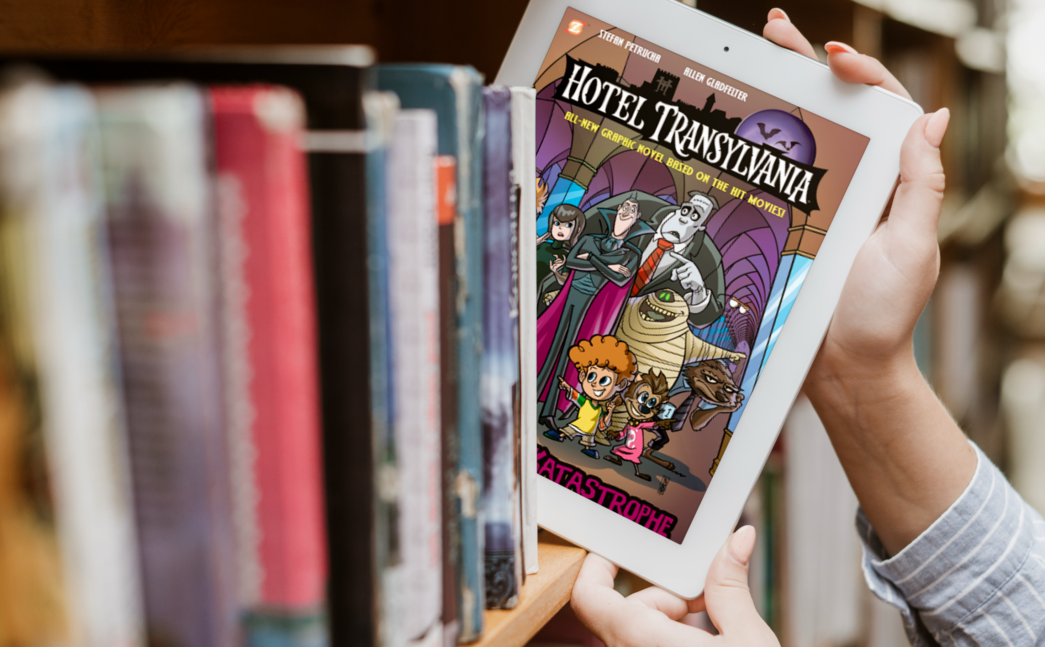


Comics Plus ウェビナー
The Role Manga Plays in Learning English and Understanding Japanese Culture - Introduction to Comics Plus
2023年7月26日10:00-11:00

Slide 2


Slide 3
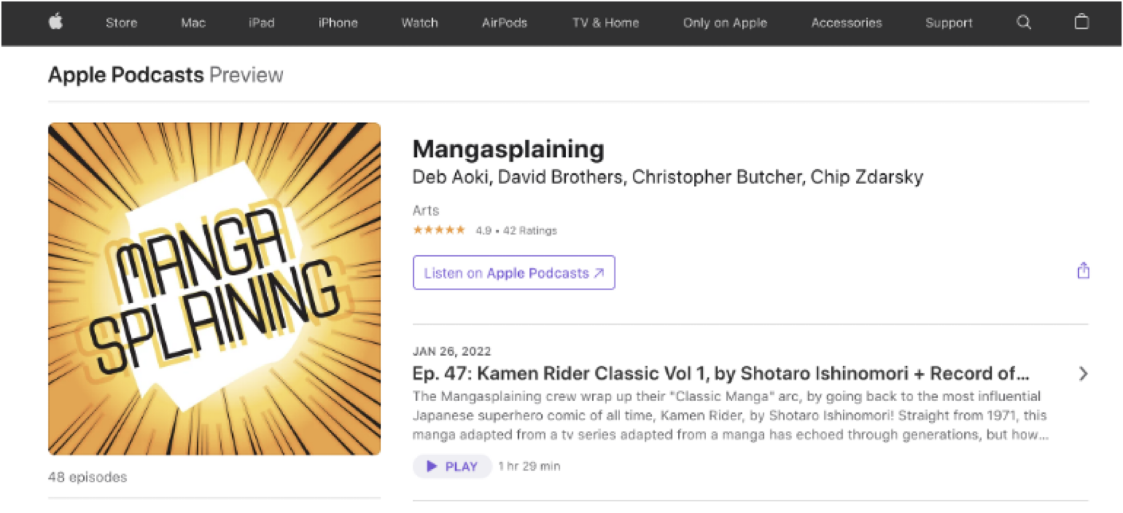

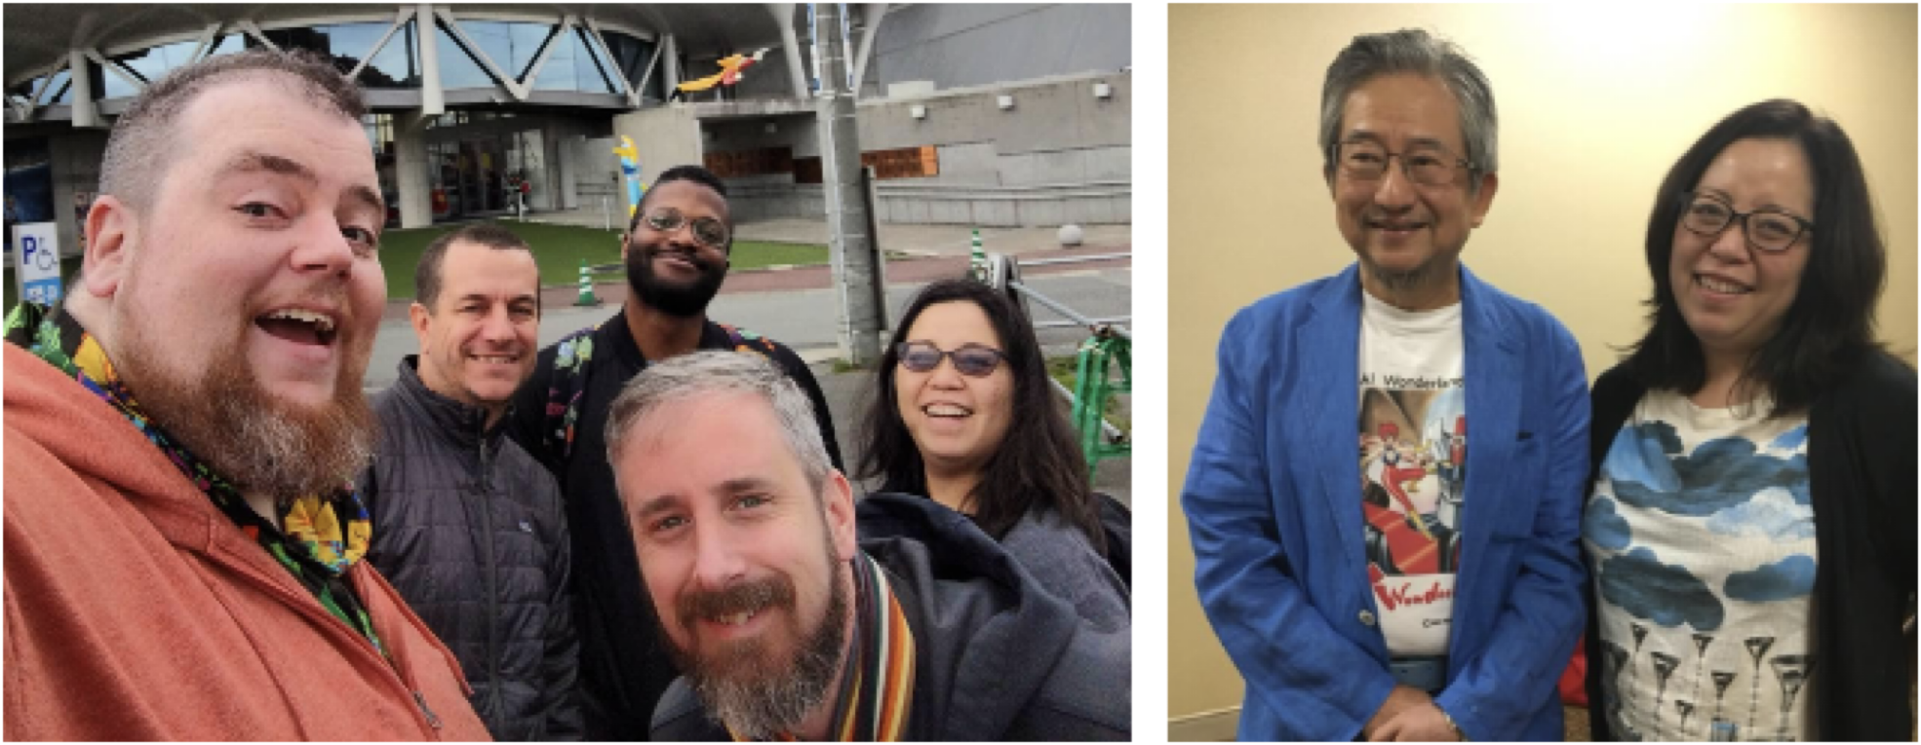
www.mangasplaining.com

Slide 4
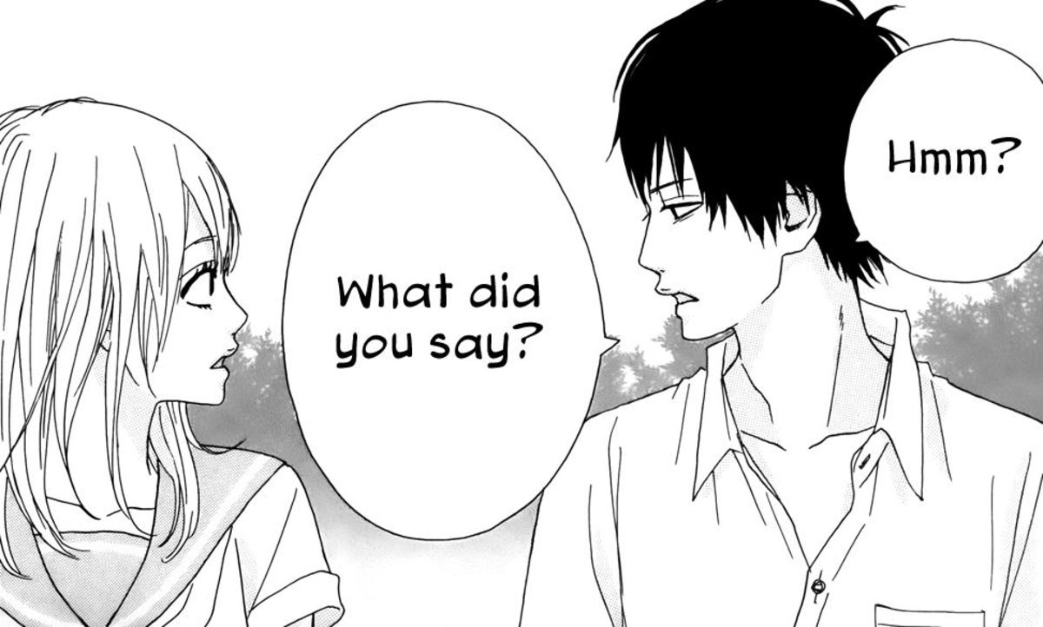
How to use manga / comics for English learning
Pick a story that you would read and enjoy in Japanese to make it fun to learn
Find series that are available in both English and Japanese, so you can compare
Look for comics that use simple, conversational English. Manga/comics for kids or teens are a good place to start
Look for ways that the dialogue in the translated version conveys (or doesn’t convey) gender, age, personality, politeness / rudeness, relationships / intimacy in how they speak
Keep a notebook handy to write and compare phrases in both English and Japanese or words to look up later

Slide 5



Wolf Children:
Ame and Yuki
BY MAMORU HOSODA and YU
The manga adaptation of Mamoru Hosoda’s animated film, Ōkami Kodomo no Ame to Yuki.
A familiar story that will be easy to follow as a manga adaptation, and easy to find in Japanese
Set in modern-day Japan, it includes casual, conversational English
Complete in 1 volume

Slide 6
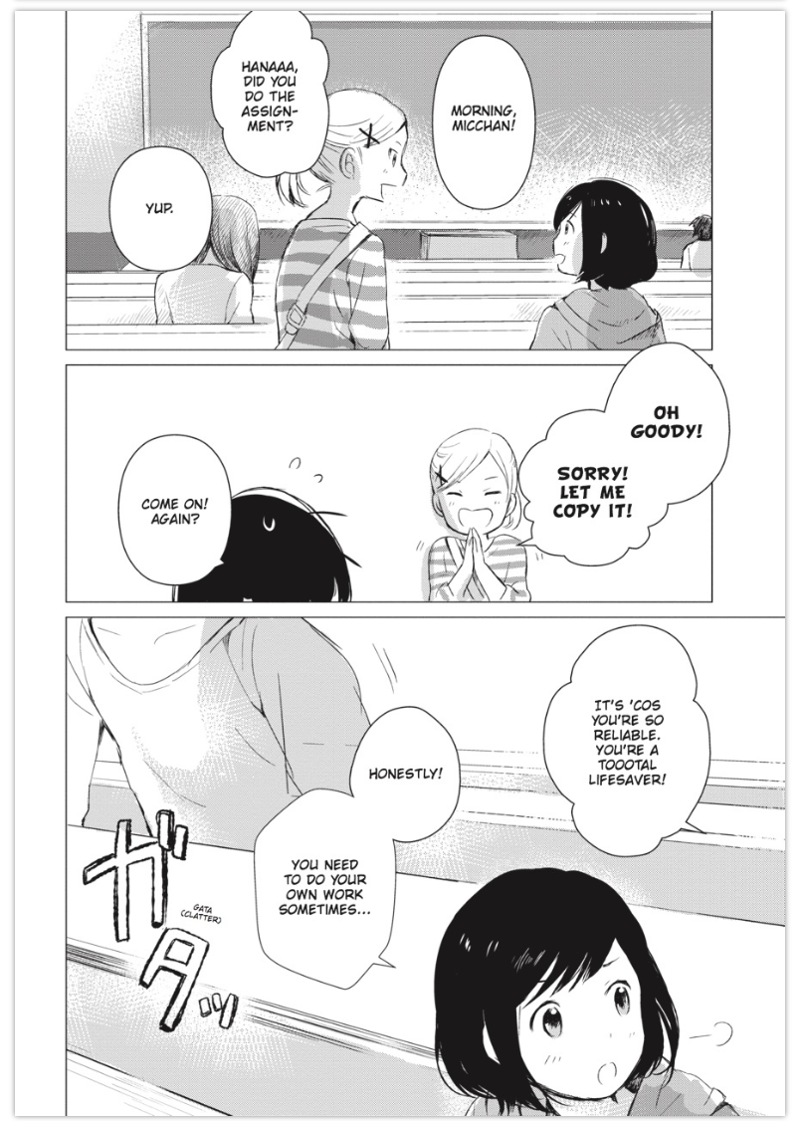
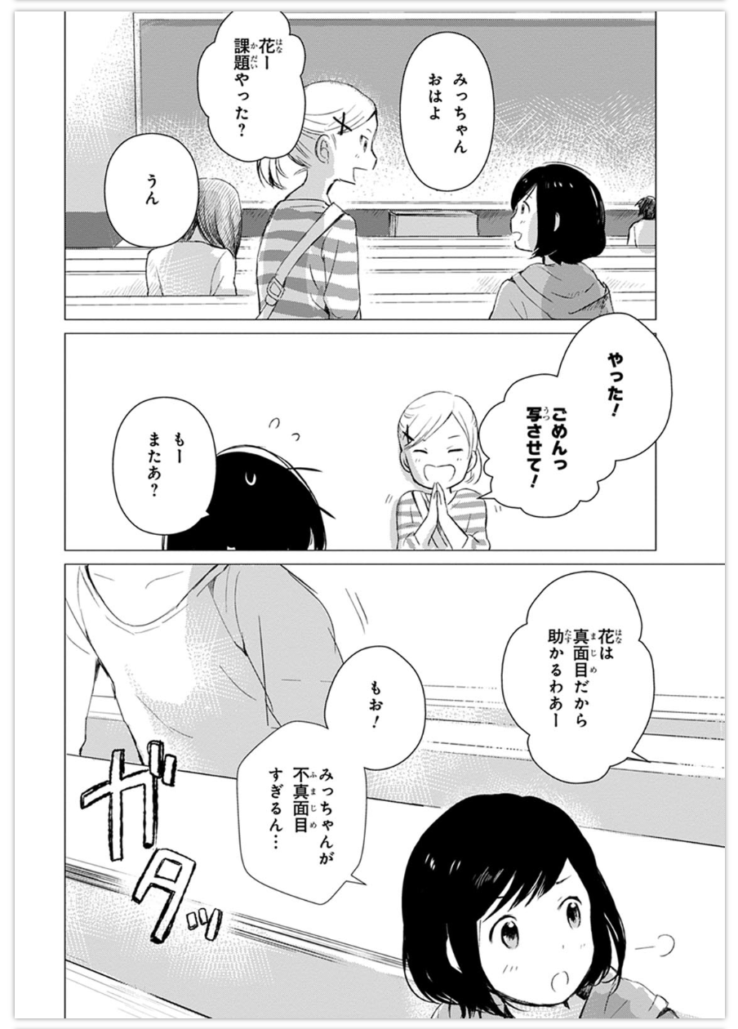
Japanese: “Yatta!”
English: “Oh goody!”
Japanese: Hana wa majime dakara tasukaruwaa
English: It’s ‘cos you’re so reliable. You’re a tooootal lifesaver!
Notes:
Japanese: “Yatta!”
English: “Oh goody!”
Japanese: Hana wa majime dakara tasukaruwaa
English: It’s ‘cos you’re so reliable. You’re a tooootal lifesaver!

Slide 7


Hana-chan and the Shape of the World
BY RYOTARO UEDA
A slice of life story about a little girl that’s full of charming, heart-warming moments.
Hana uses some child-like descriptions of things she sees and feels. Compare with how the adults around her talk.
Complete in 1 volume

Slide 8
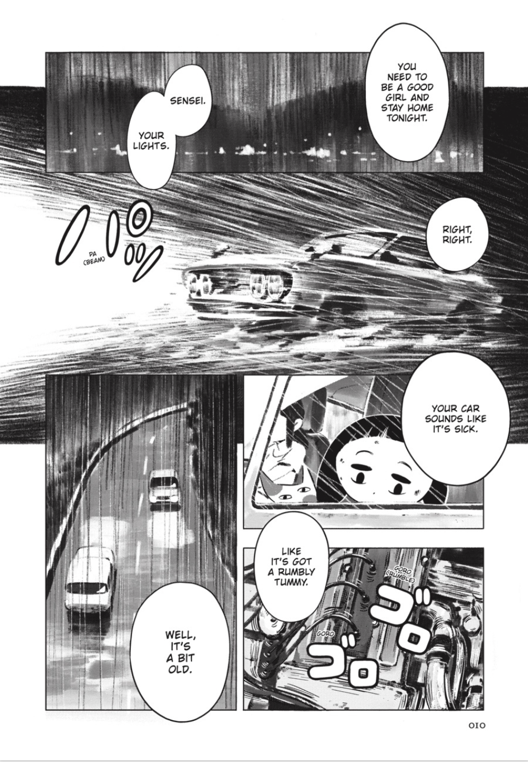
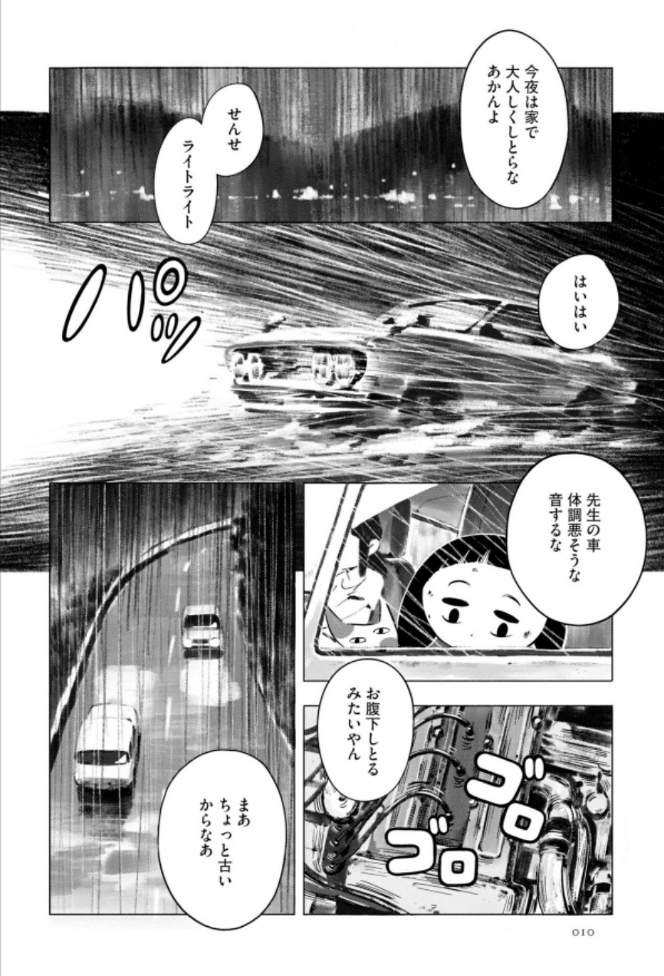
Japanese: Onaka-jo shitoru mitaiyan
English: Like it’s got a rumbly tummy.

Slide 9
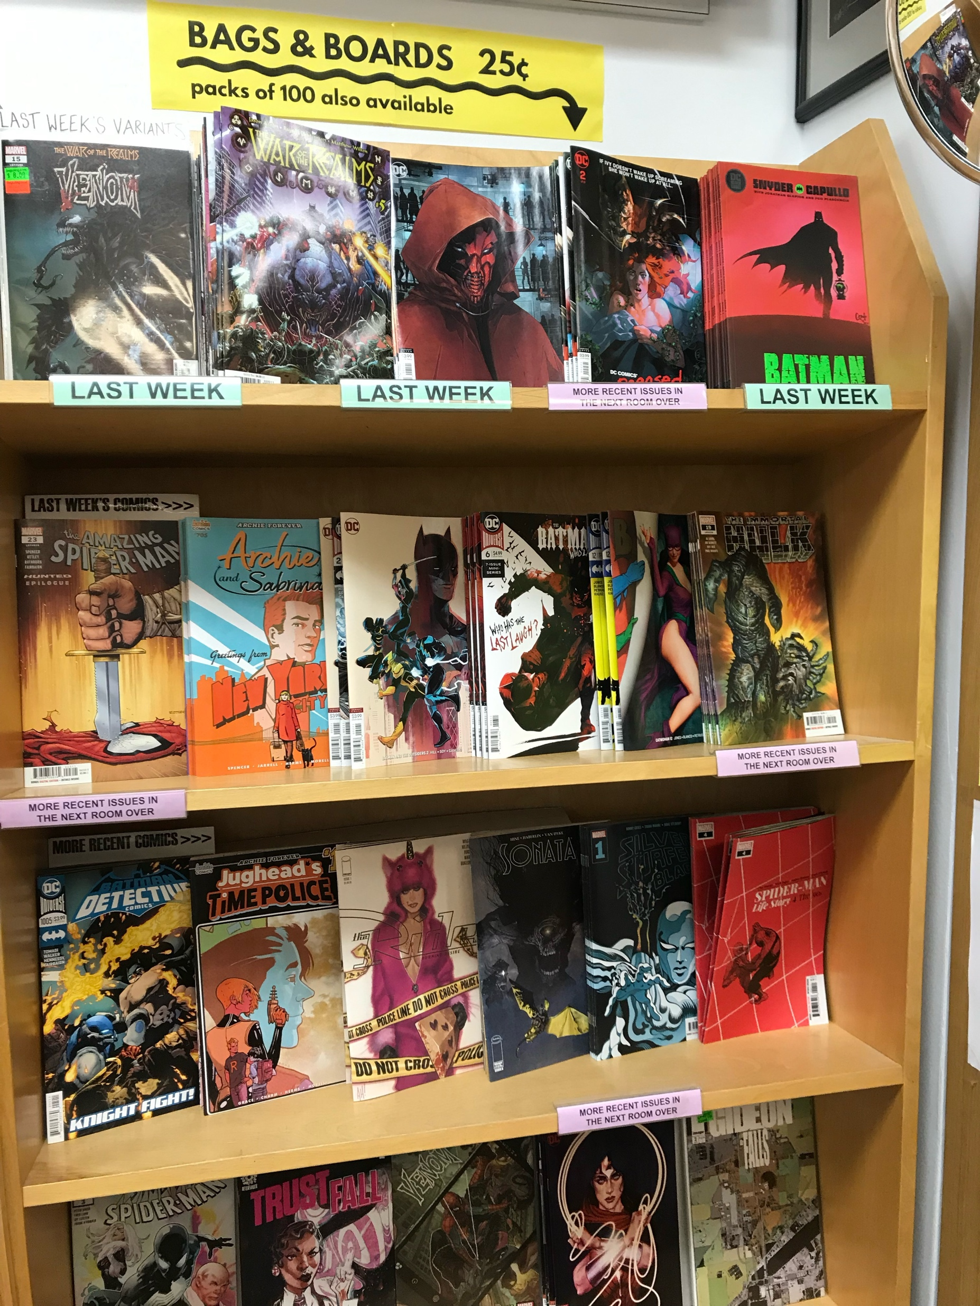
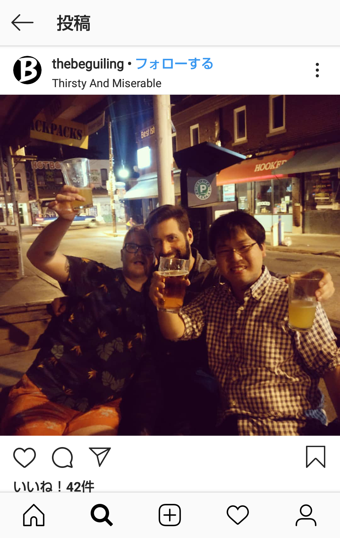
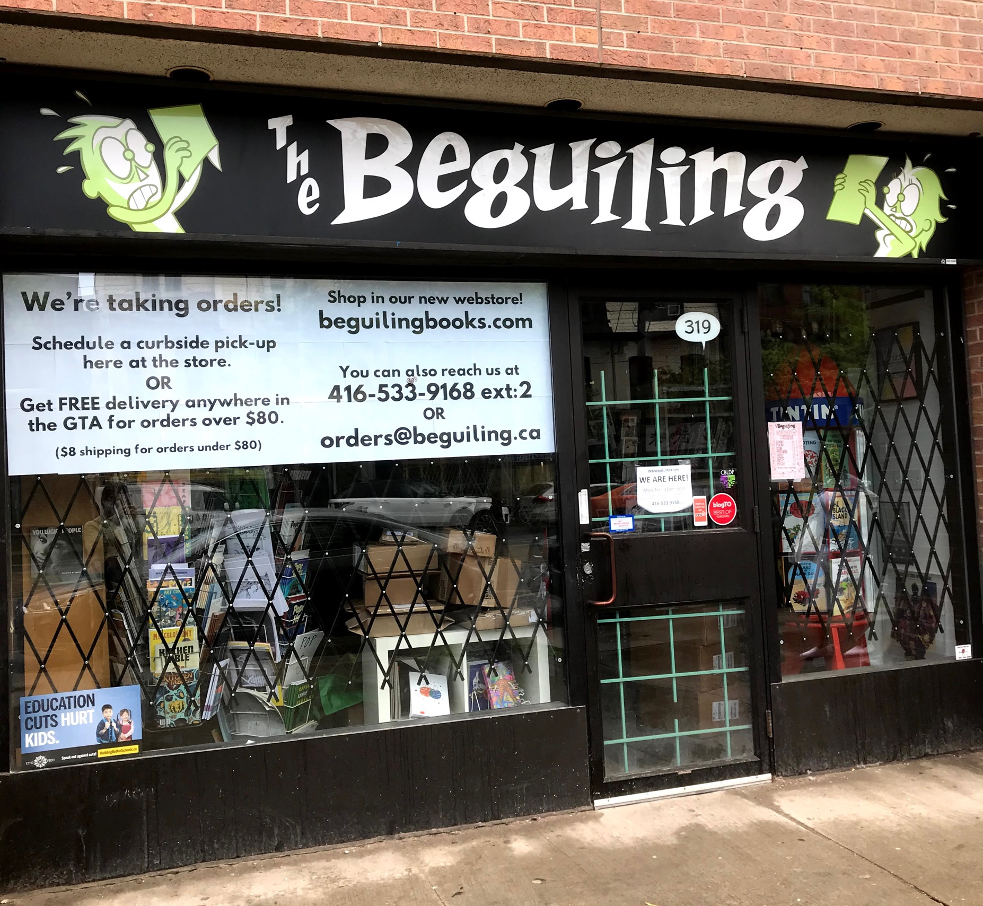
Kei Iwata
The Beguiling
Toronto, Canada

Slide 10

Peanuts
BY CHARLES SCHULZ
Written in easy English
Most comic strips are 4-panel strips, or the Sunday strips are self-contained stories, so it doesn’t require a lot of reading / time commitment
Familiar characters, enjoyable, accessible humor and easy to find in English

Slide 11
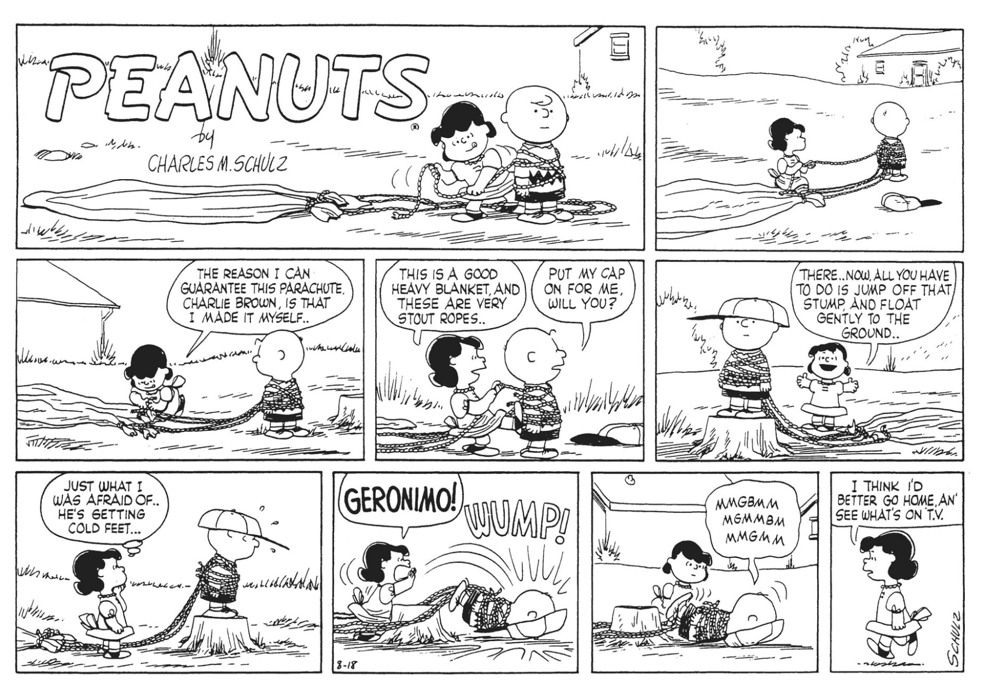
Peanuts
BY CHARLES SCHULZ
Written in easy English
Most comic strips are 4-panel strips, or the Sunday strips are self-contained stories, so it doesn’t require a lot of reading / time commitment
Familiar characters, enjoyable, accessible humor and easy to find in English

Slide 12

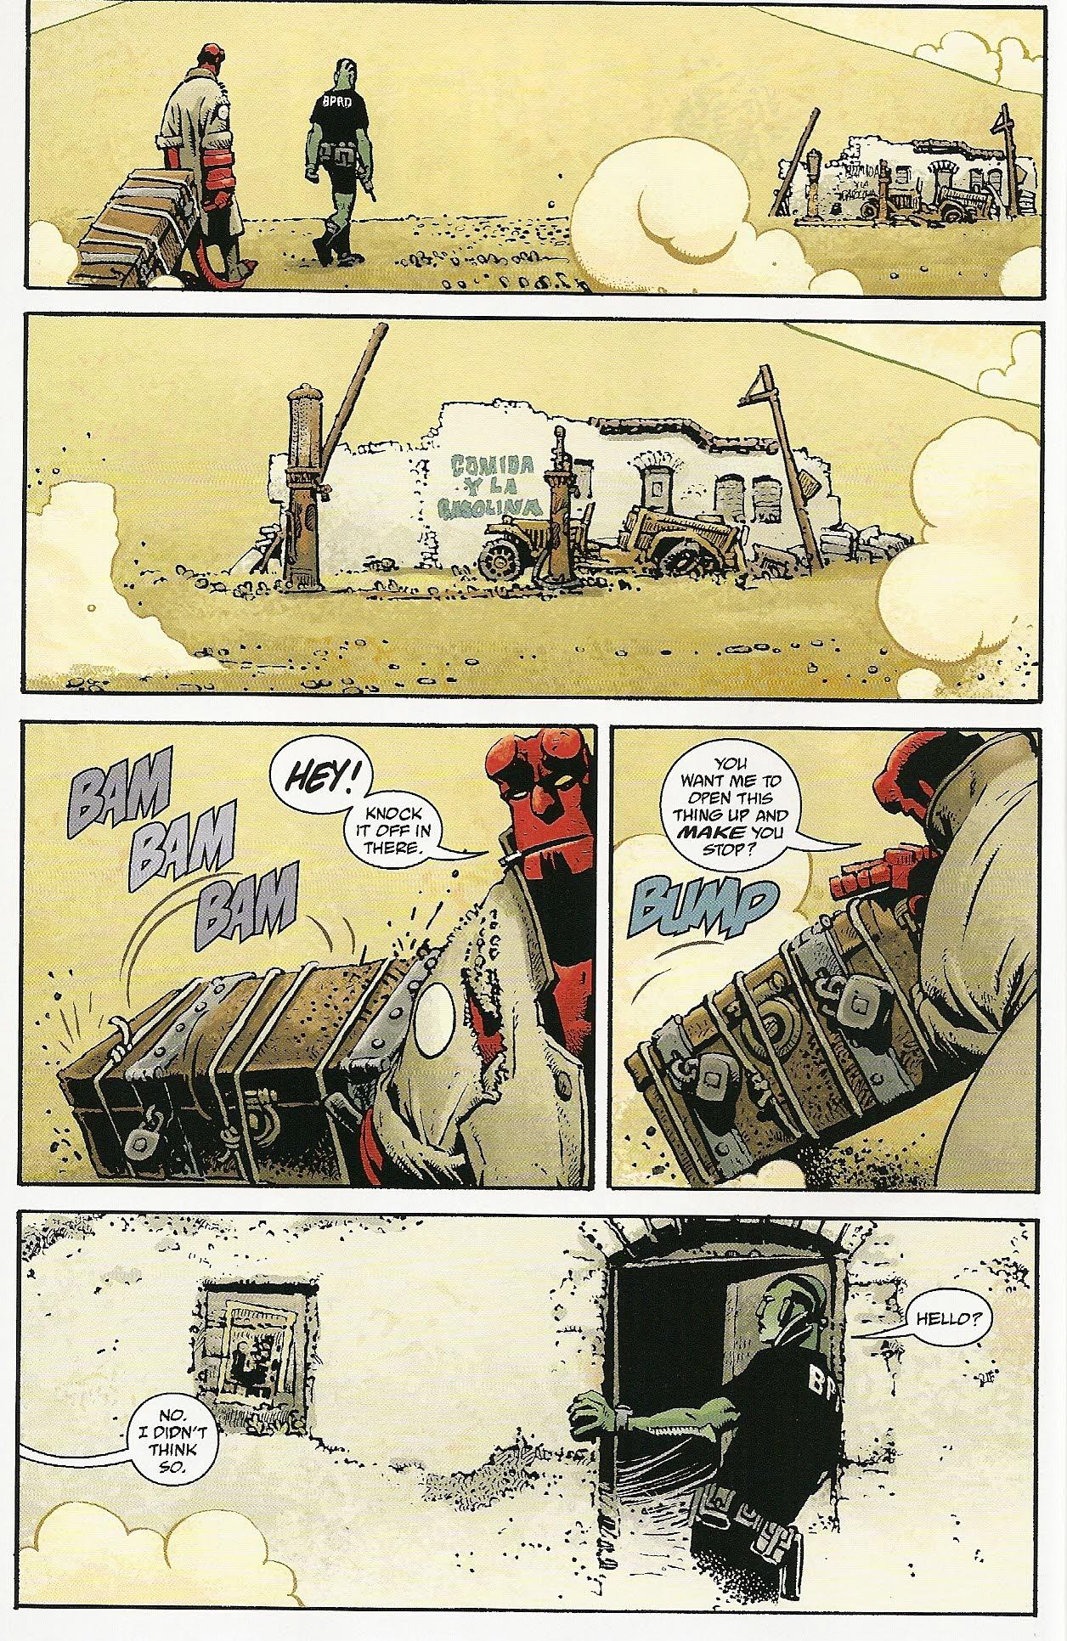
Hellboy
CREATED BY MIKE MIGNOLA
During the WW2, some Nazi occultists had summoned a demon from hell, but he was found by Trevor Bruttenholm, who raised him as an ordinary kid. Now Hellboy, having filed down his horns, fights against paranormal threats to protect the human world.
Great for fans of monsters, horror stories, and great comics.
Adapted into a feature film series
Mostly written in easy, conversational English
Hellboy: The Complete Short Stories vol. 1 and 2 may be the good starting point. Includes several Hellboy stories drawn by a variety of artists.

Slide 13

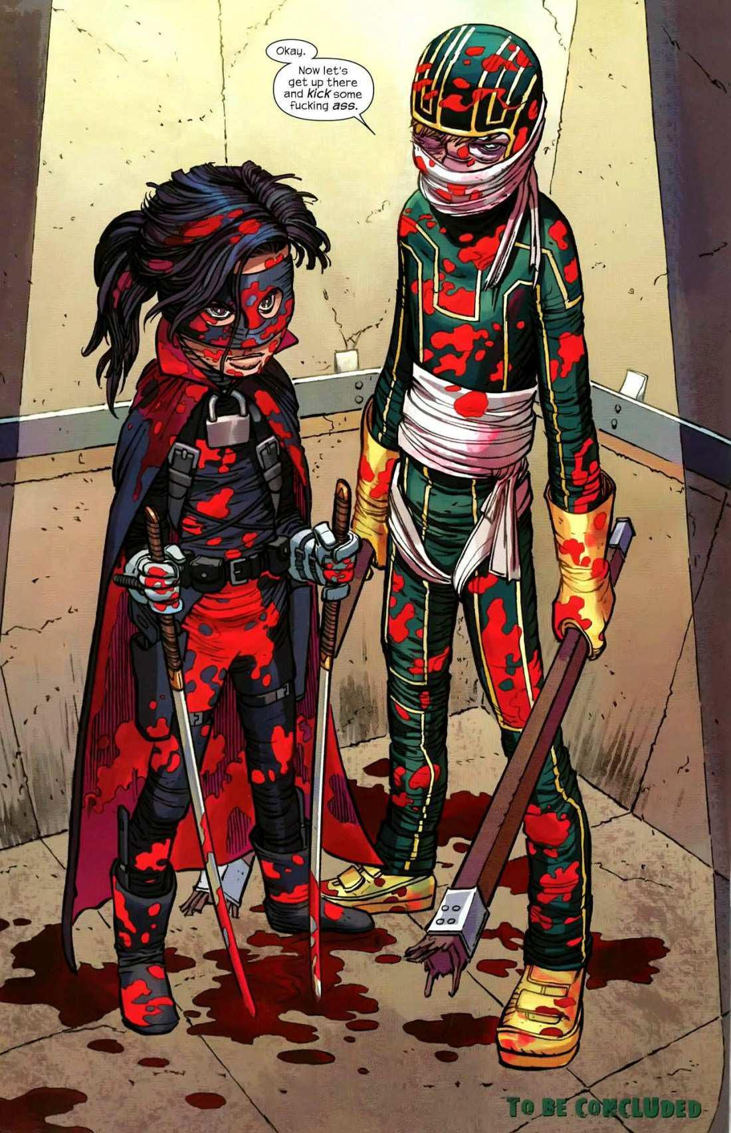
Kick-Ass
CREATED BY MARK MILLAR
AND JOHN ROMITA JR.
Dave Lizewski, a superhero comics nerd, wonders why there are no superheroes in the real world. One day, he makes up his mind to wear a costume which he bought from eBay and fight evil.
Great if you like violent, bloody comics
Helps you read real-life English, which includes vulgar language, like “fu*k”s and “sh*t”s” plus … other phrases.
There are also lots of pop culture references in this series that you can either look up or just ignore them. You don’t need to be a nerd to enjoy the story of a nerd.

Slide 14
Yuta Okada

Slide 15

特徴 ①
EXPAND AND EXCITE READERS
2万冊を超える英語のデジタルコミックが定額読み放題
無制限の同時アクセスが可能
スマートフォン、タブレット、PC等様々な端末で利用可能
コミックをダウンロードすることで、オフラインでも閲覧可能
※スマートフォン、タブレット向けアプリから利用の際に限ります
大学生の英語学習に最適
留学生向けサービスとして活用可能

Slide 16

特徴 ②
EXPAND AND EXCITE READERS
Featured（特集）, Popular（人気）, Just Added（新作）, Categories（カテゴリー）, Publishers（出版社）別にタイトルを簡単に検索
マイシェルフから最近読んだタイトルやお気に入りのタイトルをチェック
図書館員は、必要に応じてタイトルを選別（削除）することが可能
パーマリンク機能を使って、おすすめのタイトルを間単に紹介

Slide 17

ご契約情報
CONTRACT INFORMATION
契約可能対象 ： 大学図書館
契約形式 ： 年間契約
提供パッケージ： ①フルタイトル パッケージ（約21,000タイトル）
②初年度特別割引パッケージ（約14,000タイトル）
価格 ： 大学図書館様の学生数により異なります。
具体的な価格につきましては、丸善雄松堂様へお問い合わせください。
※初年度特別割引パッケージはフルタイトルパッケージの30-10%引きとなります

Slide 18






MARUZEN-YUSHODO & BIBLIOTHECA
取り扱いタイトル数は日々増え続けています。
大学生向けの読み放題サービスとして是非ご検討ください。

Slide 19
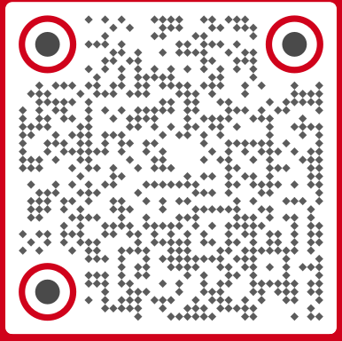

ご参加いただきありがとうございます。
y.okada@bibliotheca.com
akemi.kobori@maruzen.co.jp

